Slide 1
Feature toggling

Slide 2
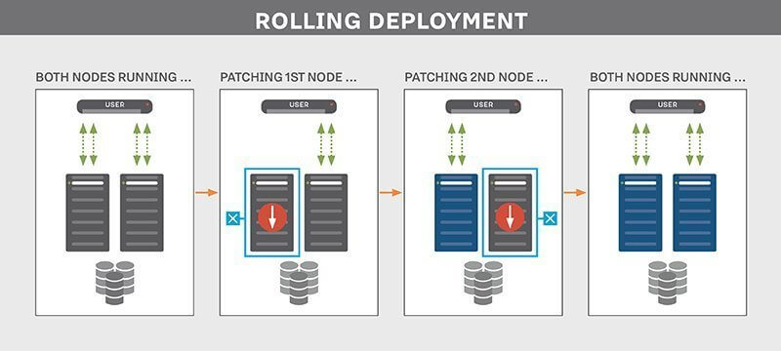
Why Feature flags
The Pains of Long-Lived Branching Merge conflicts, Deploy code in logical chunks. Even if a feature is not fully ready, it can be flagged ‘off’, but still deployed. Manageable code reviews.
Canary deploy
Low risk, turn off directly if errors.
Simultanious turn on new functionality across Microservices. Chances are that when you finish a feature, it also depends on another service, and thus they need to be released in a certain order. This makes release management harder than it needs to be.
No needs for feature environments.
Simpler Distributed architecture One of the drawbacks of rolling deployments is that two versions of the application are deployed simultaneously for a short time. This could lead to unpredictable behavior if you’re not careful.

Slide 3
Types of feature toggles
Release toggles are feature toggles that decouple deployment from the release of the feature. Toggles of this type should be short-lived since you will have to maintain the old code until the toggle is removed, even though it will never provide any business value anymore.
Ops toggles are feature toggles that ops can use to disable certain functionality in a crisis. They can be viewed as ‘manual circuit breakers’. These toggles can live a very long time in your application, but should always provide acceptable fallback behavior.
Experiment toggles are feature toggles that can be compared to release toggles, except that they are only enabled for a certain set of users. This set of users can be a predefined list of specific users or chosen at random. The experiment toggle should only exist until the feature is released to everyone, or it is decided the feature will not make it to the general public.

Slide 4
Drawbacks of feature toggles
Increases the complexity of your application. You have to utilize an if-statement or strategy pattern to execute a different path in your code. If you do not remove the toggles when appropriate, the abundance of toggles can hurt the maintainability of your code.
Introduces testing complexity. You will have to write tests for both the on and off state of your toggle. When creating multiple toggles that overlap, testing complexity might increase so much it becomes a serious problem.
Feature toggles are not a good fit for everything; large architectural changes cannot be covered by a feature toggle. In these cases, you’ll have to come up with a different solution as you might have done before.

Slide 5
Process changes
A solution to these problems is to keep the number of feature toggles to a minimum and remove them as soon as possible. You should set up a process in your team, such as creating a product backlog item containing the removal of the feature toggle. This also helps the product owner to be aware of the technical debt still present in the application.
Deploy on Friday?
Release Notes?
Deploy Approvals?

Slide 6
A fictional Example
Azure Application Configuration
Get Feature flags
Get Feature flags
BFF (Virto)
Extend Message or create new Message Type V2
Frontend
V1
Wheelchange MS
Organization MS
PublisherV1
ConsumerV1
Client
PublisherV2
ConsumerV2
V2
Client
V1
Vehicle MS

Slide 7
Further reading
https://docs.microsoft.com/sv-se/azure/azure-app-configuration/quickstart-feature-flag-aspnet-core

